Slide 1
Customer Profiling and Segmentation
Kanchana Kuraaku
Neela

Slide 2
…
Overview
- Project Goal:
  - Analyze customer data to identify distinct customer segments.
  - Use machine learning clustering techniques (K-Means and DBSCAN) to uncover patterns.
- Business Purpose:
  - Help businesses understand their customers better.
  - Improve marketing strategies by targeting specific customer groups.
- Techniques Used:
  - K-Means Clustering: Groups customers based on similarities in data features.
  - DBSCAN (Density-Based Clustering): Identifies clusters with varying shapes and handles noise.
Objective
- Data Description:
  - The dataset contains customer-related attributes such as:
    - Demographic information (age, gender, income).
    - Behavioral data (purchase history, spending habits).
    - Location-based data (region, city).
- Business Goal:
  - Segmentation: Categorize customers into meaningful clusters.
  - Targeted Marketing: Enable businesses to design personalized campaigns for each customer group.

Slide 3
Exploratory Data Analysis
The goal of EDA is to better understand the data without making assumptions. This helps with data preprocessing, feature engineering, and building models.
The steps in Exploratory Data Analysis (EDA) are:
- Summary Statistics: Dataset's distribution and patterns, encapsulated through metrics such as mean, median, mode, variance, standard deviation, range, percentiles, and quartiles.
- Data collection: Gather data from various sources.
- Data cleaning : Handle missing values, outliers, and inconsistencies.
- Feature engineering : Create new variables from existing ones to improve model performance.
- Outlier detection : Identify and remove outliers that can make models less accurate.
- Data visualization: Create graphical representations to see patterns, correlations, and outliers.

Slide 4
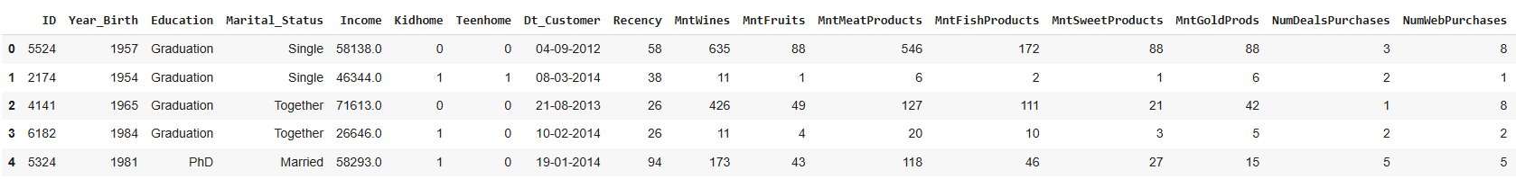
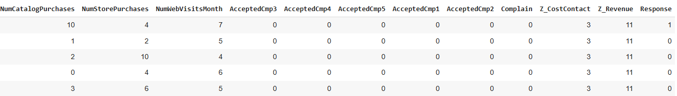
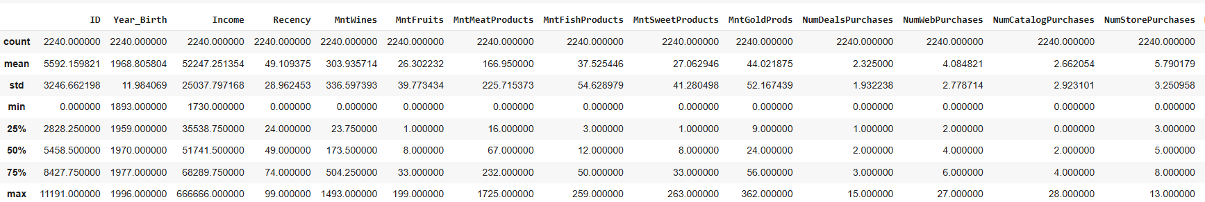

Summary Statistics
.

Slide 5
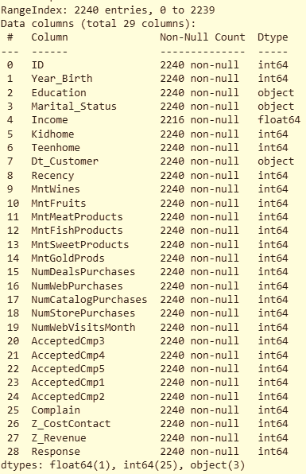
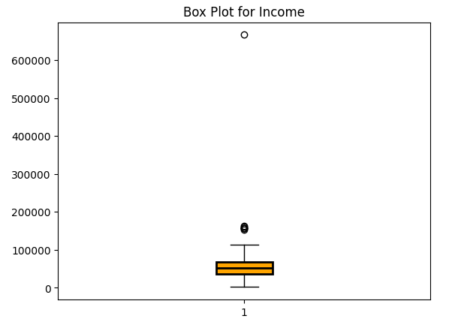
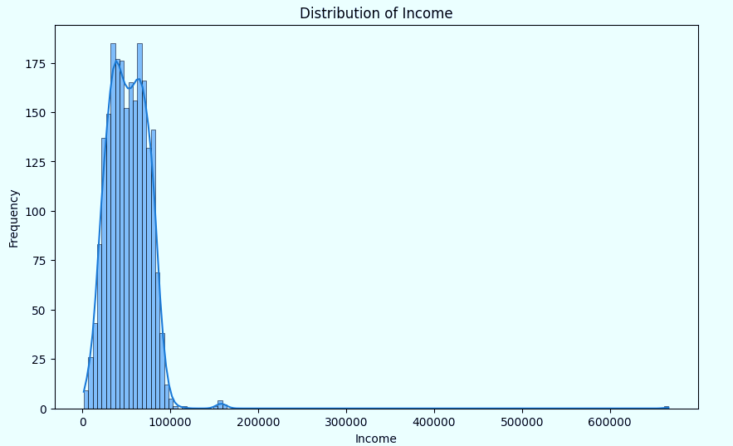
Data cleaning
.
The "income" attribute has null values and is right-skewed, so the median is used to replace the null values.

Slide 6
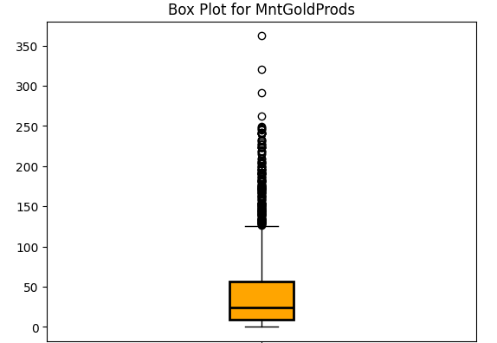
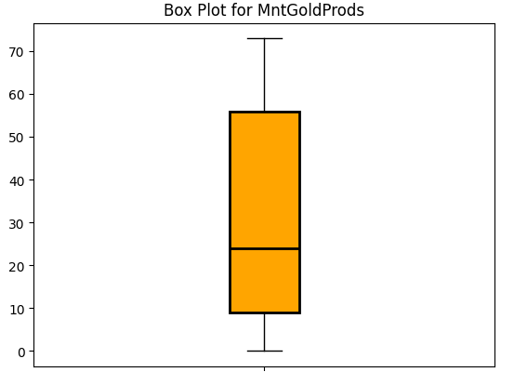
Outlier Treatment
Outliers are data points that significantly differ from the rest of a dataset. These unusually high or low values can distort statistical analyses or models if not managed properly.
Handling Outliers:
Removing: If the outliers are due to errors or irrelevant, they can be removed.
Transforming: Applying log or other transformations can sometimes help in reducing the effect of outliers.
Imputation: In some cases, outliers can be replaced with a more reasonable value based on other data points (imputation).
How Winsorization works : It limits extreme values by replacing them with the nearest value within a specified percentile range.
Winsorizing was applied to features like income, spending, purchase counts, and year of birth to reduce the impact of extreme values. Box plots helped visualize outliers before and after treatment

Slide 7
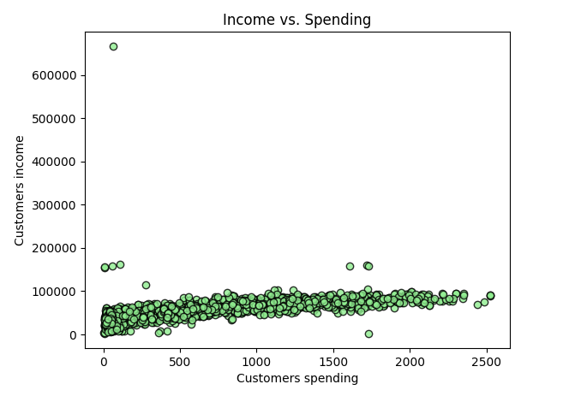
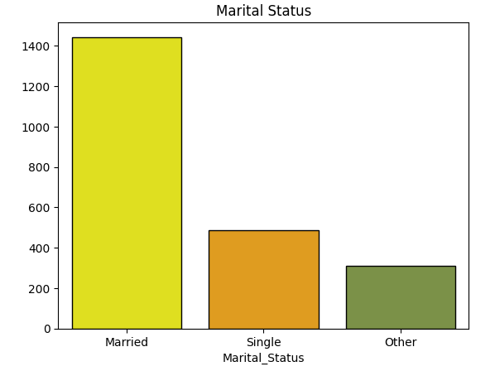

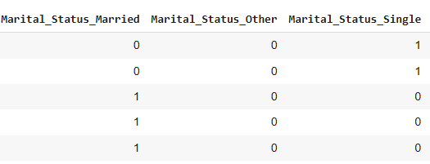
Feature Engineering
1. Creation : A new feature, amount_spent, was created by summing spending across product categories, combining related features into a single, informative measure of overall spending.
2. One-Hot Encoding of Marital_Status : The Marital_Status feature was one-hot encoded, creating binary columns for each category to replace the original column, as many machine learning algorithms cannot handle categorical features directly.

Slide 8
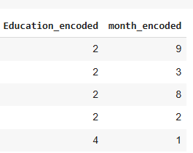
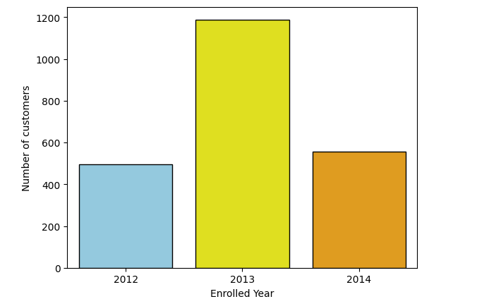
3. Label Encoding of Education and month : The Education and month columns were label encoded, mapping each category to a unique integer. This converts categorical data to numerical form but may create an unintended ordinal relationship (e.g., 'Master' as greater than 'Graduation').
4. Date Feature Extraction : The Dt_Customer feature was converted to a datetime object, and the year and month were extracted as new features, providing more useful components for the model.

Slide 9
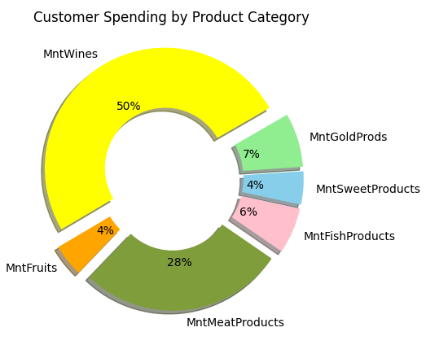
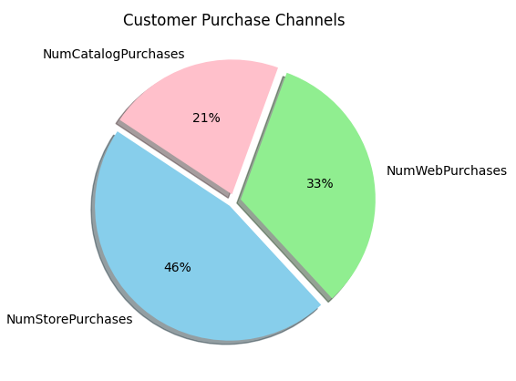
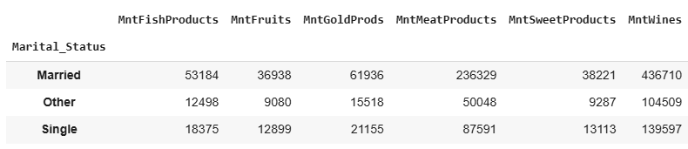
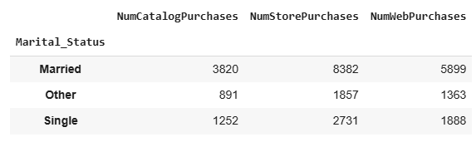
Data visualization
The pie chart shows in-store purchases at 46%, online at 33%, and catalog at 21%, highlighting a preference for traditional shopping with notable online activity. The table shows that married individuals spend more than singles.
The pie chart shows wine at 50% of spending, followed by meat at 28%. Other categories like fruits, gold, sweets, and fish make up smaller shares. The table reveals that married individuals spend more than singles.

Slide 10
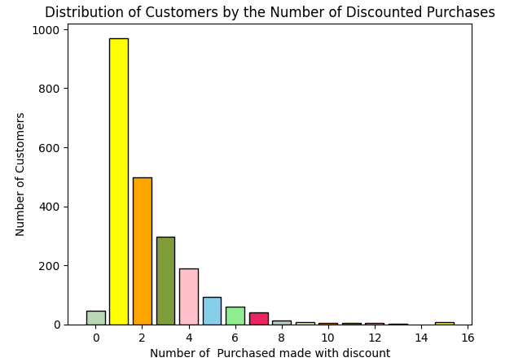
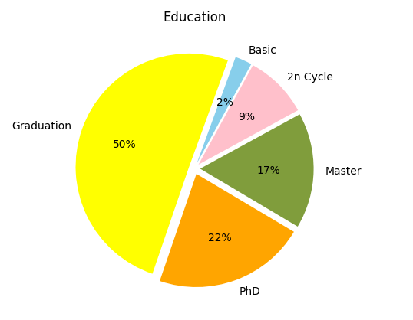
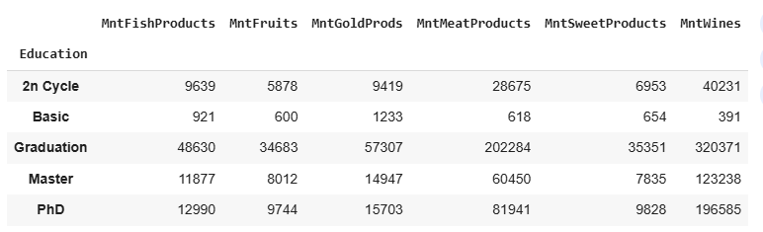

.
The graph shows most customers make only 1 discounted purchase, with a sharp drop after 2, indicating discounts have a short-term impact on repeat purchases.
Analysis shows 50% of individuals have Graduation degrees, followed by 39% with Master's and PhDs, indicating a well-educated population with diverse expertise.

Slide 11
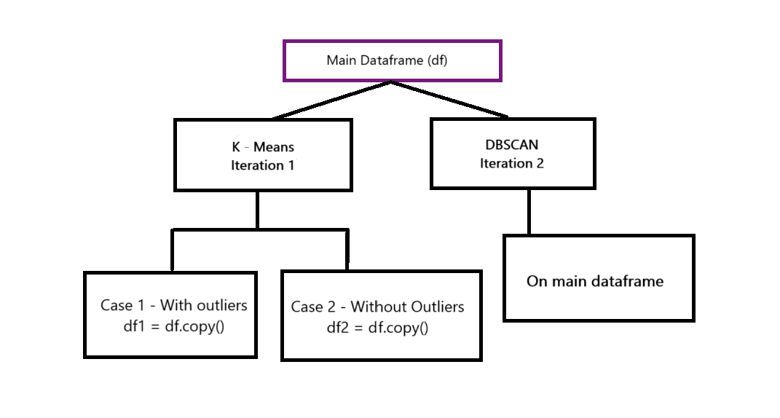
Model Building

Slide 12
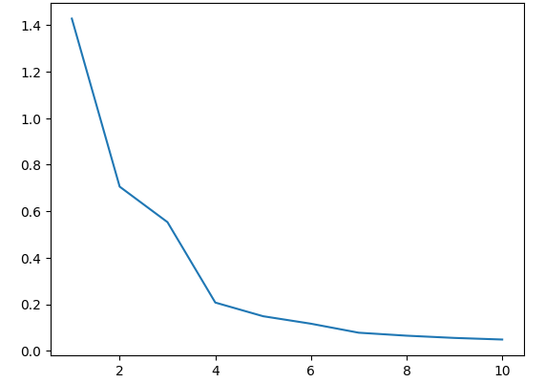
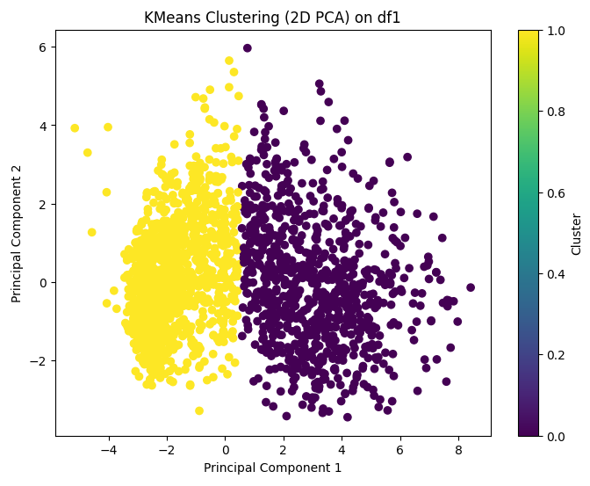
K – Means : With Outliers
The elbow plot suggests using two components for clustering, as they capture the most variance, simplifying analysis and improving interpretability.
A Silhouette Score of 0.45 indicates moderate clustering quality with some cluster overlap. Refining features or optimizing the number of clusters could improve separation and performance.
A Davies-Bouldin Index of 0.71 indicates moderate clustering performance with some overlap, as lower values signify better-defined clusters.

Slide 13
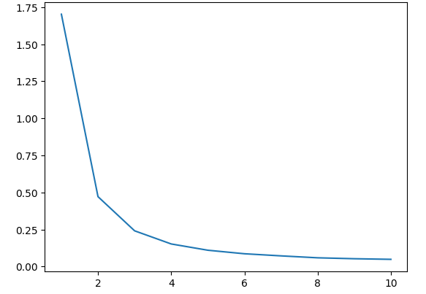
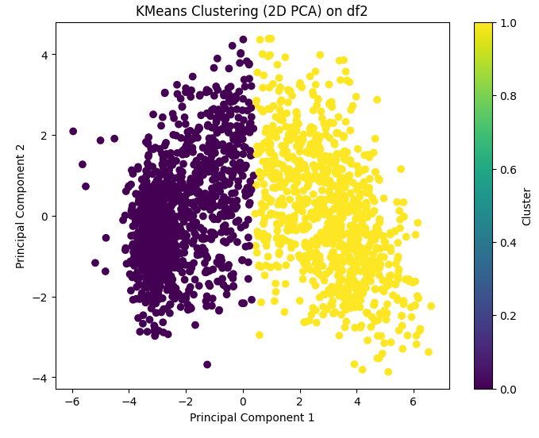
K – Means : Without Outliers
The elbow plot suggests using two components for clustering, as they capture the most variance, simplifying analysis and improving interpretability.
A Silhouette Score of 0.48 indicates moderate clustering, with some overlap. K-Means finds meaningful groups, but boundary points may be unclear.
A Davies-Bouldin Index of 0.66 suggests a fairly good clustering structure with moderate separation, as lower values indicate better-defined clusters.

Slide 14
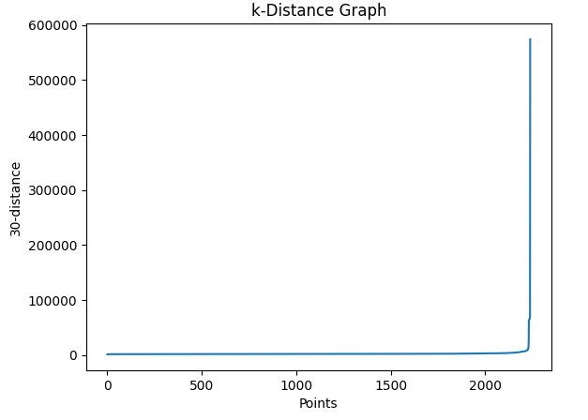
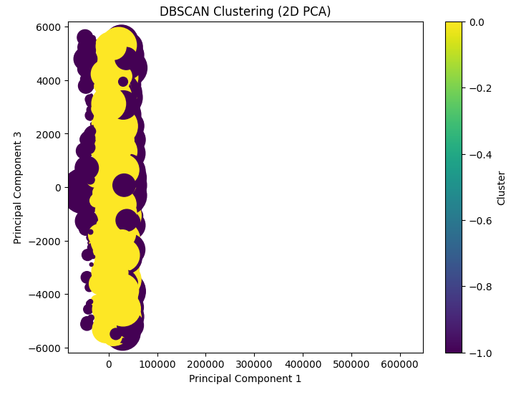

DBSCAN
The KNN elbow graph helps determine the optimal eps for DBSCAN by identifying the sharp bend in the k-distance curve. In this case, eps = 2700 is ideal, as lower values form one cluster, while higher values merge distinct groups, ensuring meaningful patterns with minimal noise.
A Silhouette Score of 0.37 for DBSCAN suggests moderate cohesion and separation, with some well-formed clusters but possible noise or overlap.
A Davies-Bouldin Index of 12.17 for DBSCAN indicates poor separation and significant overlap, as lower values signify better-defined clusters.

Slide 15
Conclusion
- DBSCAN struggles with noise and overlapping clusters, leading to poor separation.
- K-Means with outliers faces issues as outliers create overlapping clusters, reducing clarity.
- Removing outliers enhances the compactness and distinctiveness of clusters.
- This leads to better-defined segments, improving the accuracy of customer insights.
- K-Means without outliers is the most effective for customer profiling and targeted marketing.
- A well-separated clustering structure enables businesses to personalize strategies and optimize decision-making.

